Slide 1
ITDO7013: Infrastructure Security
Module 6 : Information Security and Risk Management
By: Prof. Prasad Padalkar

Slide 2
Topics
Legal System and Cybercrime,
Ethical Issues in Security Management.

Slide 3
Cybercrime
Any unlawful act where computer or communication device or computer network is used to commit or facilitate the commission of crime
– National Cyber Crime Reporting Portal
Refer https://cybercrime.gov.in/Webform/CrimeCatDes.aspx

Slide 4
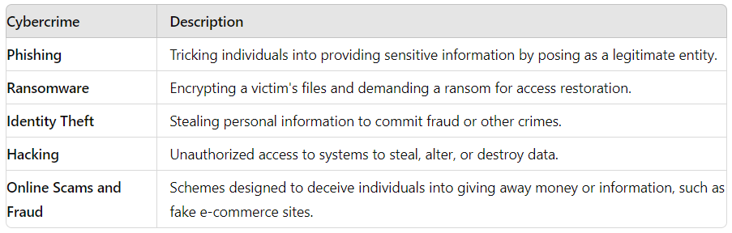
Cybercrimes

Slide 5
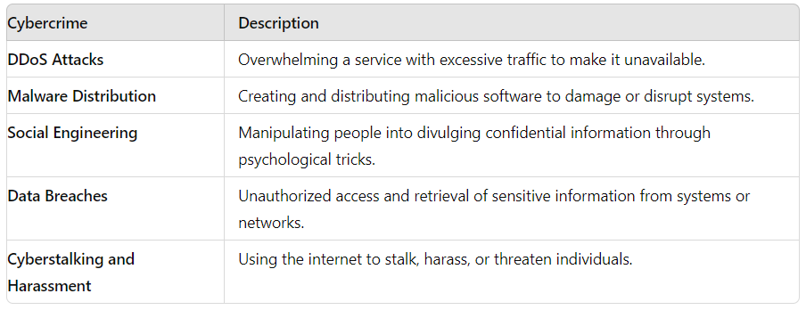
Cybercrimes

Slide 6
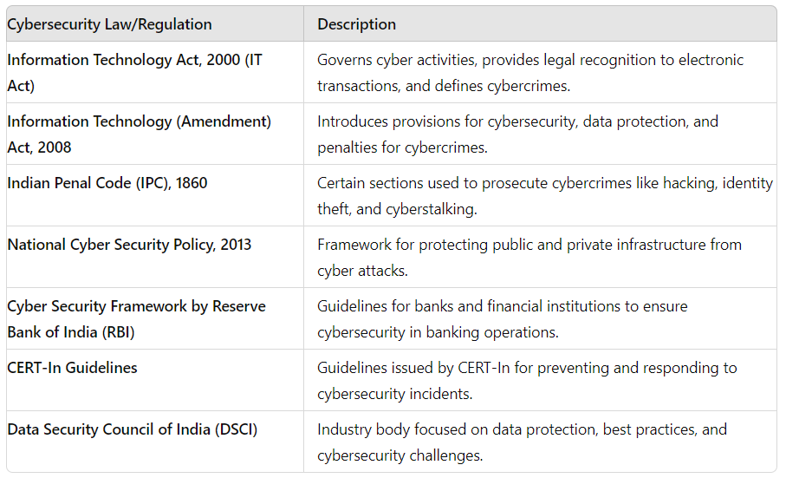
Legal Provision

Slide 7
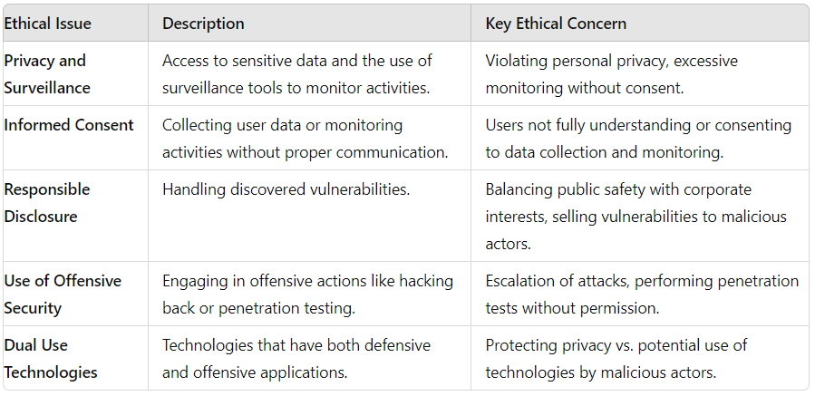
Ethical issues in Security Management

Slide 8
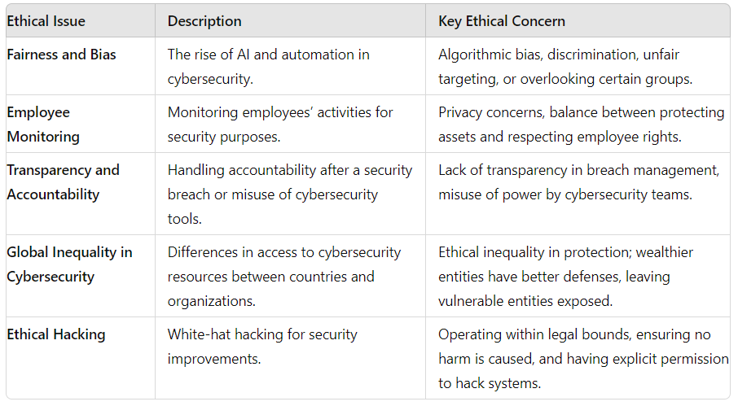
Ethical issues in Security Management

Slide 9


